Slide 1
NORTHWIND Traders Sales Analysis - bY AANCHAL JAIN

Slide 2
TOPICS
Project Overview
Information about Dataset tables
Data cleaning and Transformation
MECE-Breakdown
Solving Power Bi and EDA Questions
Dashboard Analysis
Conclusion

Slide 3
Project overview
The North wind database contains the sales data for a fictitious company called “North wind traders” which imports and exports specialty foods from around the world. The report aims to generate insights into customer behavior, sales patterns, and employee performance to aid decision-making processes. It will cover sales analysis, customer segmentation, inventory trends, and employee performance, consolidating data from multiple tables for a comprehensive view of the company's operations. The objective of this report to empower stakeholders to make data-driven decisions by offering valuable insights and facilitating data exploration through interactive visualizations and dynamic filters.

Slide 4
Information about dataset
Customers: This table contains information about customers, including their company details, contact information, and
location.
Employees: This table stores employee details like name, title, contact information, and hire date. Orders: this table captures order details such as order ID, customer ID, date, items ordered, shipping information, and freight costs.
Order details: This table provides a breakdown of each order, including specific products ordered, their quantity, and unit price.
Products: This table showcases product information like name, category, unit price, stock levels, and supplier details.
Suppliers: This table contains information about the company's suppliers, including their contact details and location.
Shippers: This table lists the shipping companies utilized by north wind traders, along with their contact information.
Categories: This table categorizes the products offered by north wind traders.

Slide 5
Data CLEANING and Transformation
Remove unnecessary columns.
Eliminate columns with a high percentage of null values.
Merge columns to create new ones, such as combining first and last names into a full name.
Rename columns for better clarity.
Derive the gender column from the TitleOfCourtesy
Correct data types as needed.

Slide 6
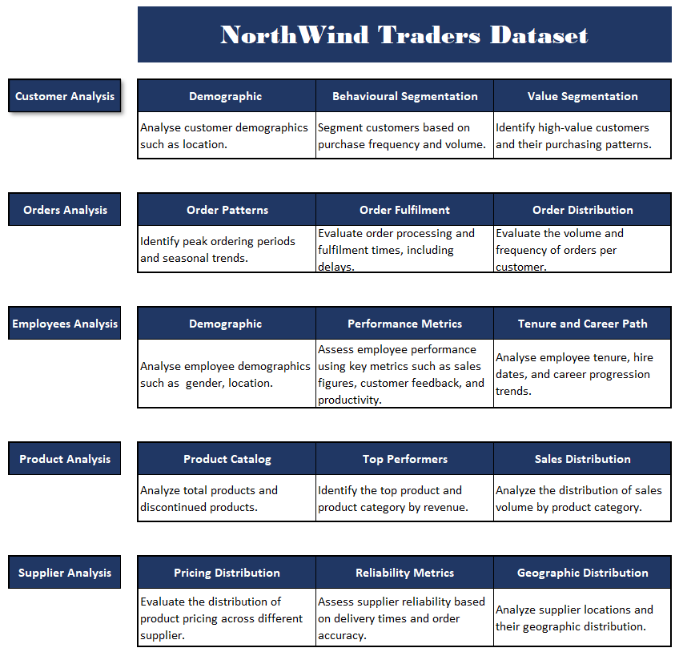
MECE BREAKDOWN

Slide 7
POWER BI QUESTIONS
How does customer distribution vary across different regions or customer segments? Can we visualize it on a map or bar chart?
What is the trend in customer acquisition over time? Can we create a line chart or area chart to display it?
Can we visualize the distribution of customer demographics such as age, gender, or income using histograms or pie charts?
How does order volume change over time? Can we create a time series chart or stacked bar chart to visualize it?
What is the distribution of order values? Can we create a histogram or box plot to display it?
Can we visualize the average order processing time or shipping duration using a bar chart or box plot?
How does employee productivity vary across different departments or job roles? Can we create a stacked bar chart or grouped column chart to visualize it?
What is the distribution of employee tenure? Can we create a histogram or box plot to display it?
Can we visualize employee performance ratings or KPIs using a radar chart or bullet graph?
What is the distribution of product ratings or reviews? Can we create a histogram or stacked bar chart to visualize it?
How does the sales volume vary across different product categories? Can we create a bar chart or treemap to display it?
Can we visualize the pricing distribution of products using a box plot or violin plot?
What is the distribution of supplier ratings or performance metrics? Can we create a bar chart or radar chart to visualize it?
How does the cost or pricing structure vary across different suppliers? Can we create a box plot or stacked bar chart to display it?
Can we visualize the geographical distribution of suppliers using a map or bubble chart?

Slide 8
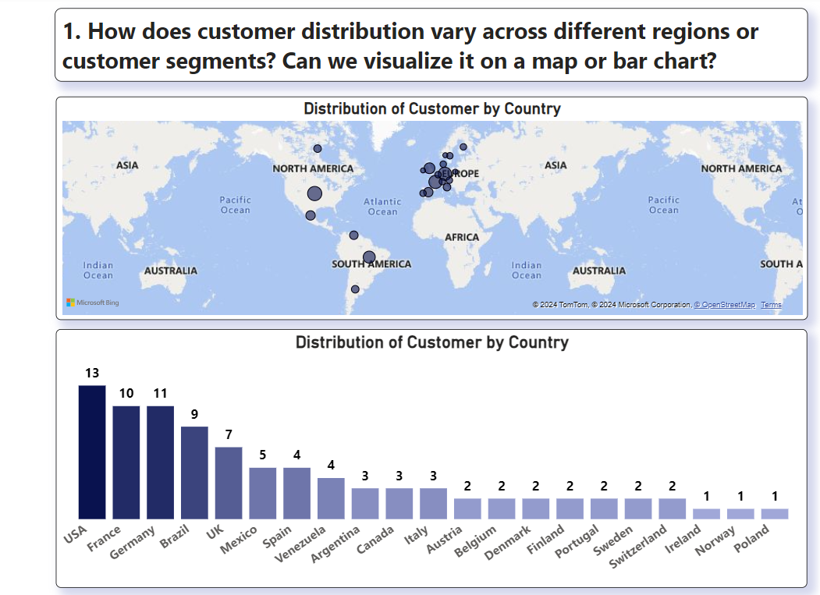
Conclusions:
USA has the most customers, followed by France and Germany.
Europe dominates the customer base.
Insights:
Expand in Europe: Strengthen market presence in Europe.
Explore Growth: Investigate opportunities in countries with fewer customers.
Targeted Marketing: Segment customers by location for effective campaigns.

Slide 9
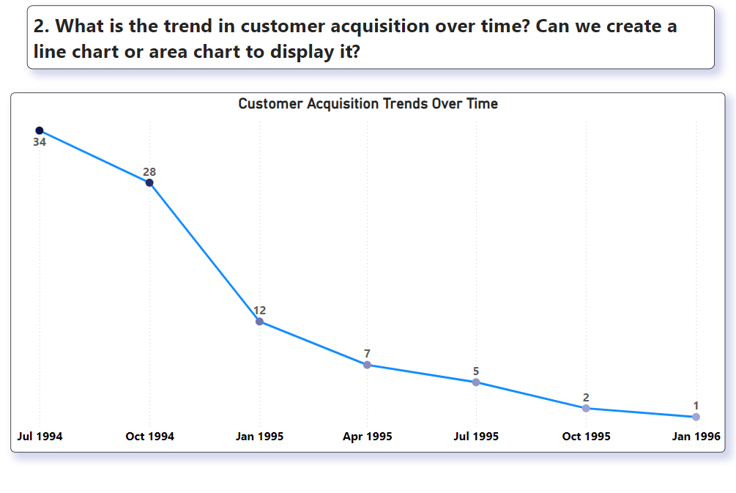
Conclusions:
Decline in customer acquisition from July 1994 to January 1996.
Peak in July 1994.
Insights:
Analyze Decline: Investigate the reasons for the drop.
Improve Retention: Focus on keeping existing customers.
Revise Marketing: Update strategies to attract new customers.

Slide 10
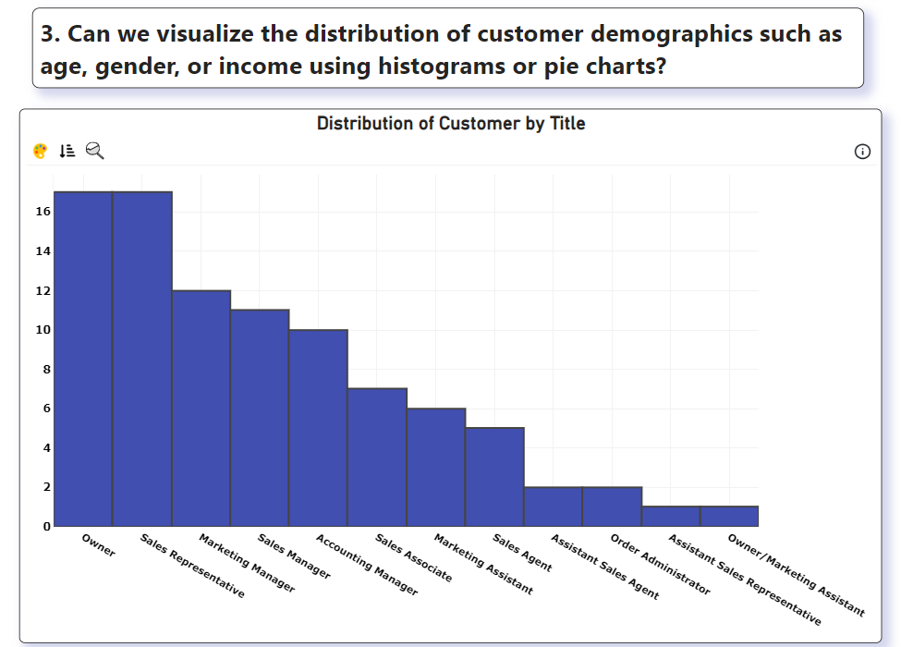
Conclusions:
Most customers are Owners, Sales Representatives, and Marketing Managers.
Fewer customers have Assistant roles.
Insights:
Target Key Titles: Focus marketing on Owners, Sales Representatives, and Marketing Managers.
Understand Needs: Offer solutions tailored to these roles.
Niche Opportunities: Create products for roles with fewer customers.

Slide 11
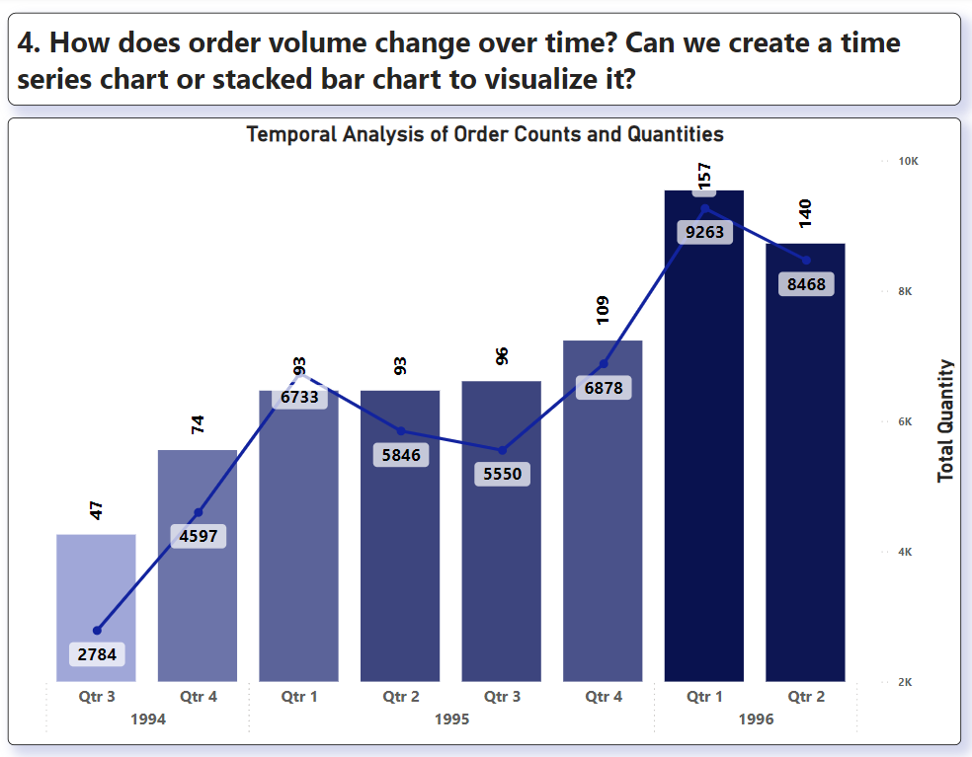
Conclusions:
There is a noticeable increase in order volume from Q3 1994 to Q1 1996.
The total quantity ordered also shows a general upward trend, with Q1 1996 having the highest quantity.
There are fluctuations in the number of orders per quarter, but the overall trend is increasing.
Actionable Insights:
Resource Allocation: Prepare for higher demand in the first quarters of each year based on historical trends.
Marketing Strategies: Intensify marketing efforts leading up to Q1 to capitalize on the increase in order volume.
Inventory Management: Ensure sufficient stock levels in anticipation of higher order quantities, especially in Q1.

Slide 12
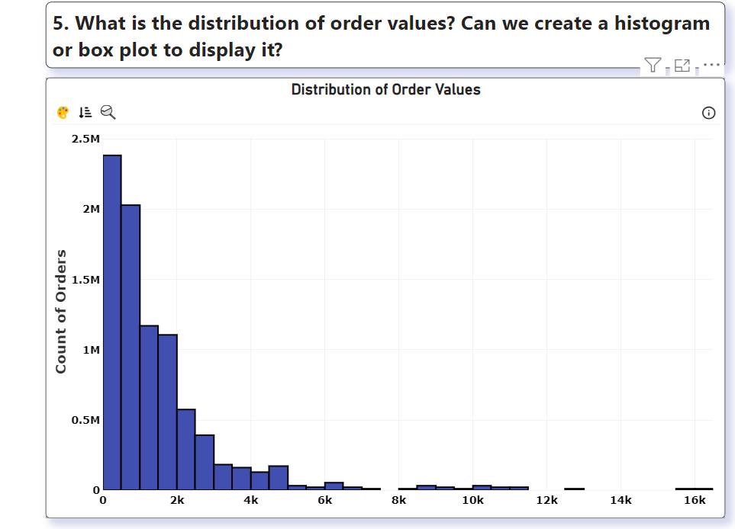
Conclusions:
The majority of orders fall within the lower value ranges (0 to 2,000).
There is a long tail distribution, with a small number of high-value orders extending up to 16,000.
Actionable Insights:
Targeted Promotions: Implement targeted promotions and discounts for higher-value orders to encourage customers to make larger purchases.
Customer Segmentation: Segment customers based on order values to tailor marketing campaigns effectively.
Sales Focus: Train the sales team to upsell and cross-sell to customers with historically lower order values to increase their average order size.

Slide 13
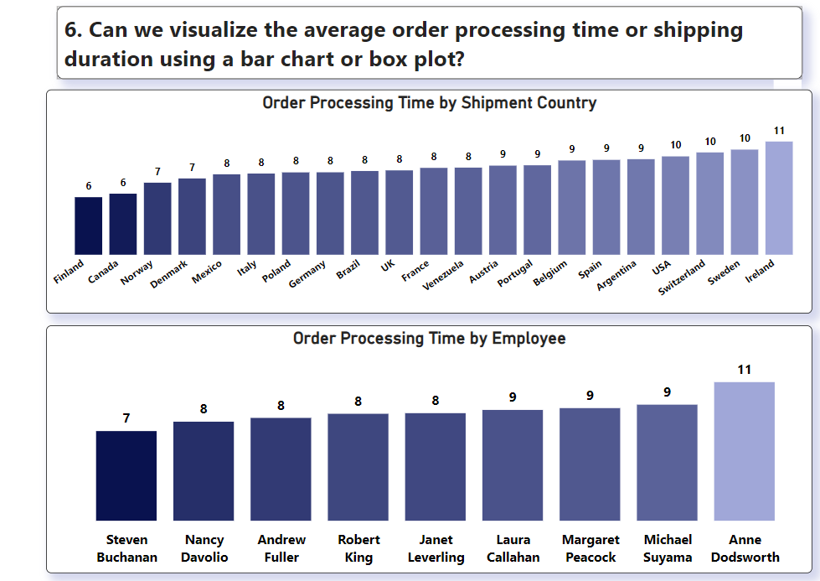
Conclusions:
By Shipment Country: Order processing times vary by country, with Finland having the shortest average processing time (6 days) and Ireland the longest (11 days).
By Employee: There are differences in processing times among employees, with Steven Buchanan having the shortest average processing time (7 days) and Anne Dodsworth the longest (11 days).
Actionable Insights:
Process Improvement: Investigate reasons for longer processing times in certain countries and streamline processes to reduce delays.
Employee Training: Provide additional training and support to employees with longer processing times to improve their efficiency.
Performance Incentives: Implement performance incentives for employees to encourage faster order processing while maintaining accuracy and quality.

Slide 14
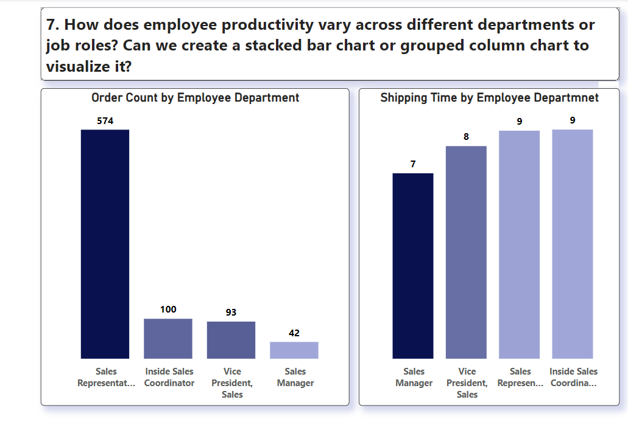
Conclusions:
Sales Representatives are handling the highest order volume, but have longer shipping times compared to other roles.
The Vice President of Sales processes fewer orders but has the second-fastest shipping time.
Actionable Insights:
Consider redistributing workload or providing additional support to Sales Representatives to improve shipping times while maintaining their high order volume.

Slide 15
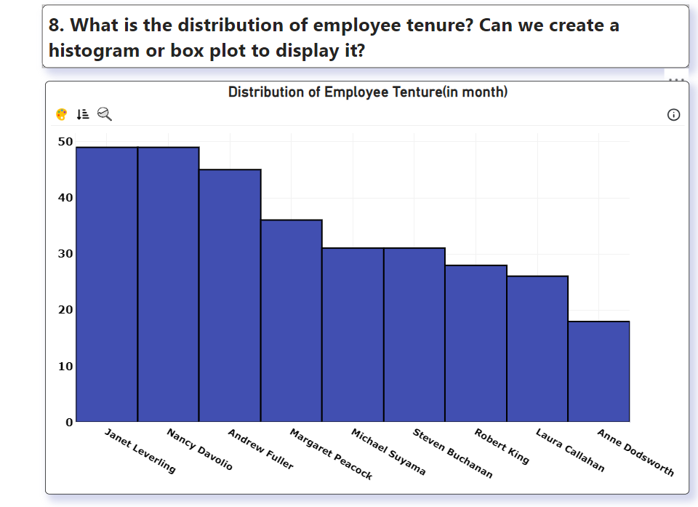
Conclusions:
Janet and Nancy are the longest-serving employees, while Anne has the shortest tenure.
The duration of employee tenure ranges from 18 to 50 months.
Actionable Insights:
Analyze factors contributing to long-term employee retention and implement strategies to improve retention for newer employees.
Consider knowledge transfer programs between long-tenured and newer employees.

Slide 16
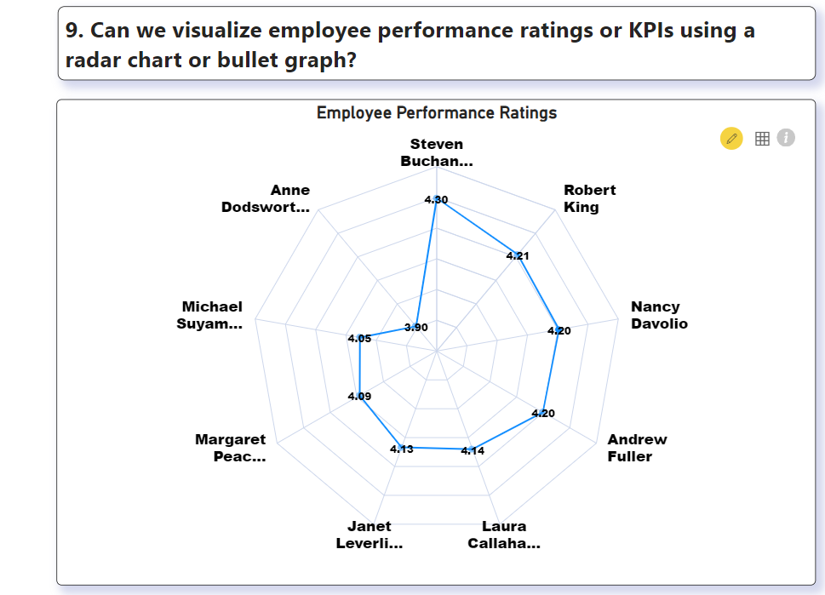
Conclusions:
Steven Buchanan has the highest performance rating (4.80), while others like Michael Suyama have lower ratings (3.90).
Actionable Insights:
Identify best practices from top performers like Steven Buchanan and implement training programs to improve overall team performance.
Provide targeted support for lower-performing employees.

Slide 17
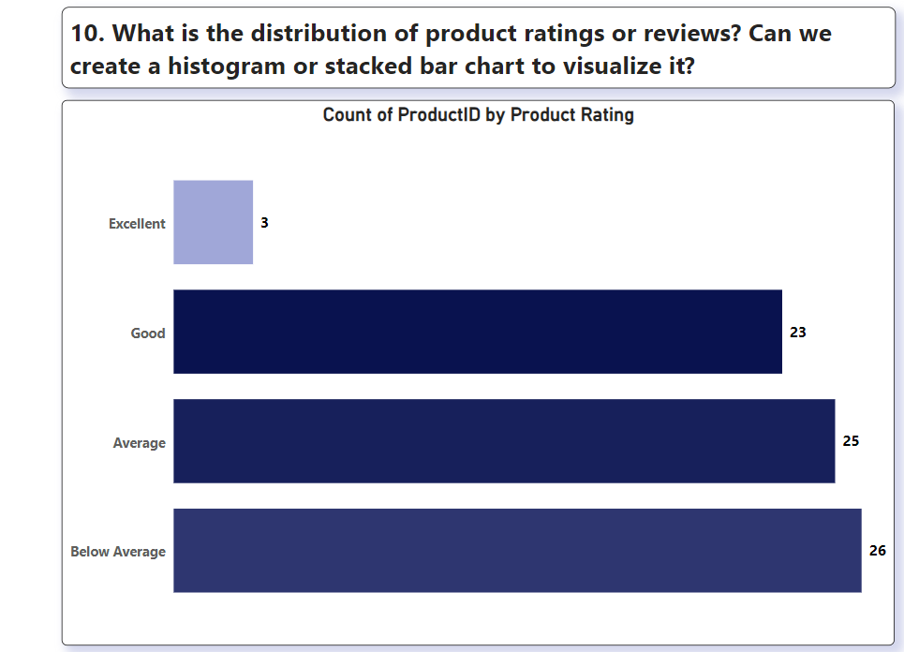
Conclusions:
Most products are rated "Average" or "Below Average", with few "Excellent" ratings.
Actionable Insights:
Focus on improving product quality and customer satisfaction.
Conduct customer surveys to understand reasons for low ratings and implement improvement strategies.

Slide 18
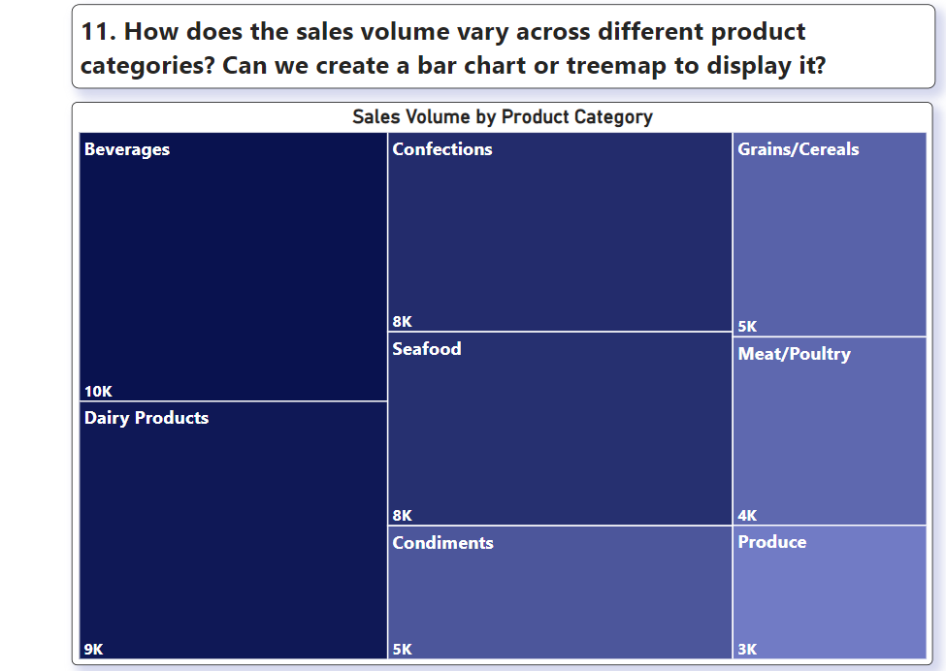
Conclusions:
Beverages and Dairy Products are the top-selling categories.
Produce and Meat/Poultry have lower sales volumes.
Actionable Insights:
Capitalize on the success of Beverages and Dairy Products by expanding these product lines or running targeted marketing campaigns.
Investigate reasons for lower sales in Produce and Meat/Poultry categories and develop strategies to boost their performance.

Slide 19
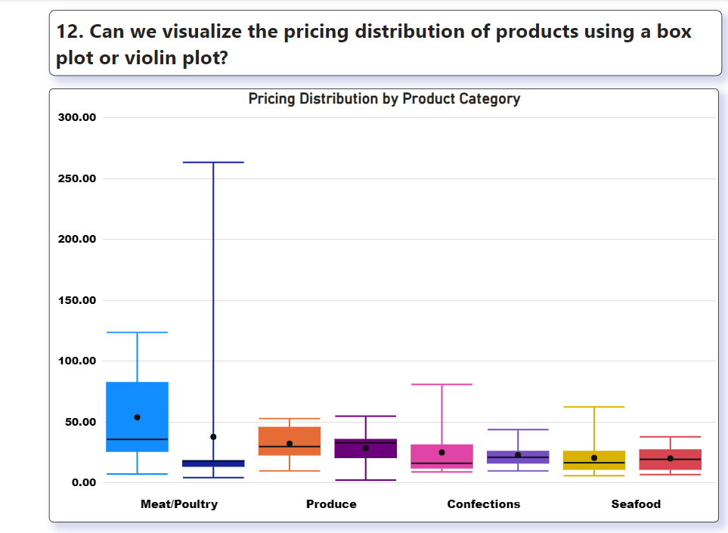
Conclusions:
There's significant price variation across product categories, with
Meat/Poultry having the widest range and
highest median price.
Actionable Insights:
Review pricing strategies, especially for categories with wide ranges.
Consider optimizing prices for profitability while remaining competitive.

Slide 20
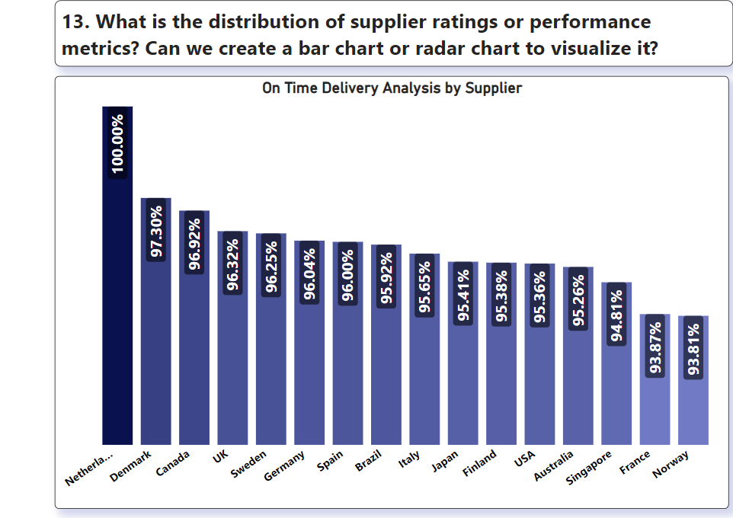
Conclusions:
Netherlands leads in on-time delivery performance (100%), followed closely by Denmark and Canada.
Actionable Insights:
Analyze practices of top-performing suppliers and apply learnings to improve overall supply chain efficiency.
Consider renegotiating terms or finding alternatives for lower-performing suppliers.

Slide 21
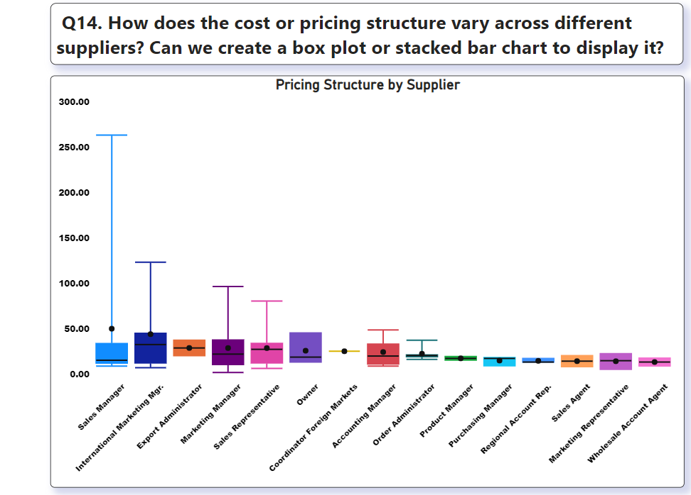
Conclusions:
Sales Managers and International Marketing Managers have the highest and most variable pricing structures.
Actionable Insights:
Review pricing authority and guidelines across roles. Implement consistent pricing policies while allowing flexibility where needed.

Slide 22
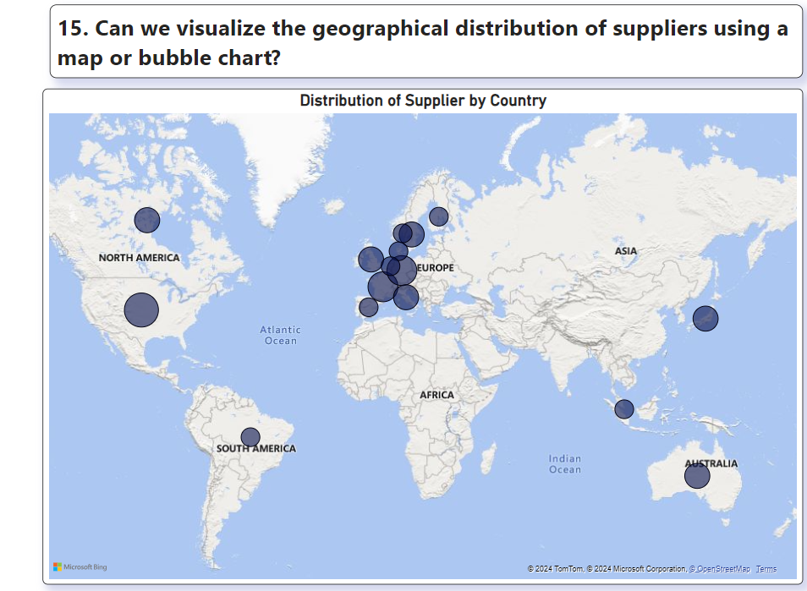
Conclusions:
Suppliers are concentrated in Europe, with fewer in other regions.
Actionable Insights:
Diversify supplier base geographically to reduce supply chain risks and potentially access new markets or products.

Slide 23
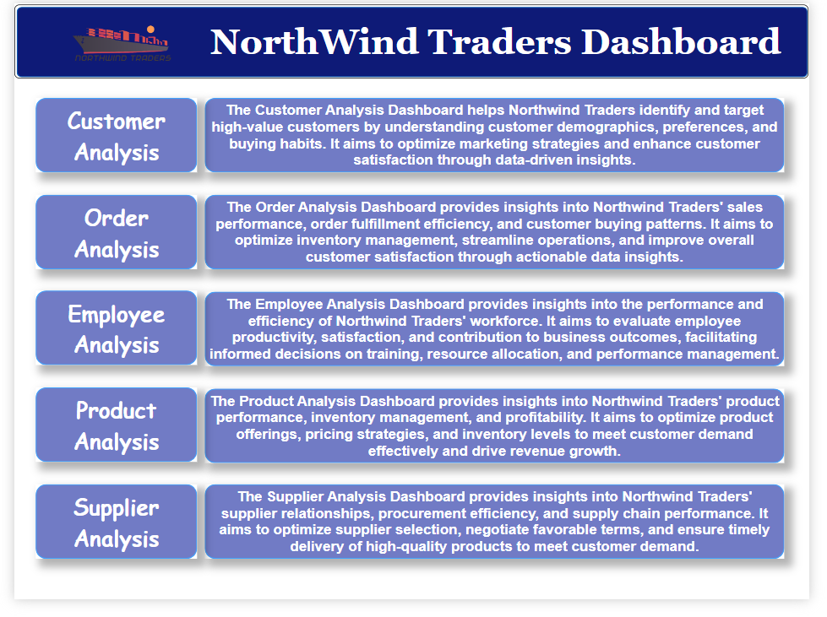

Slide 24
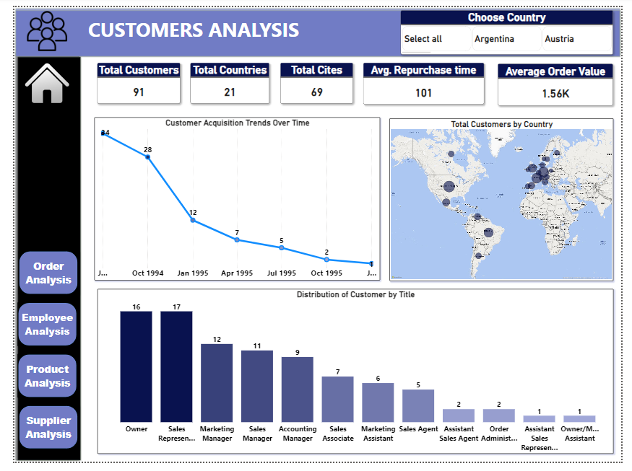

Slide 25
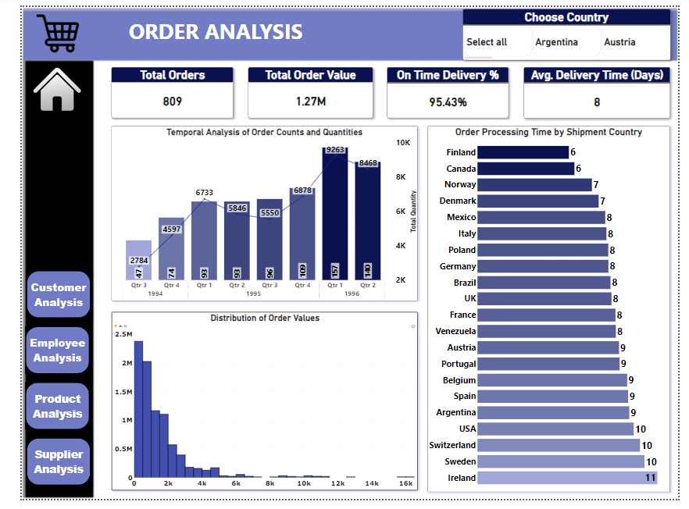

Slide 26
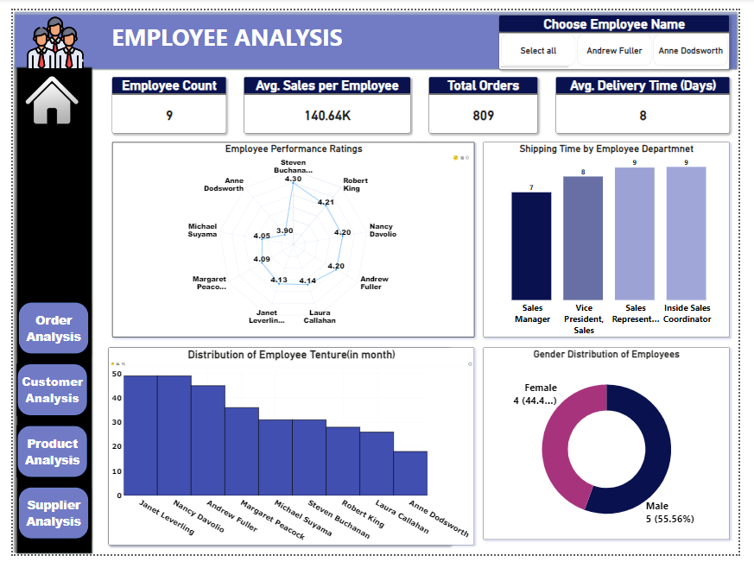

Slide 27
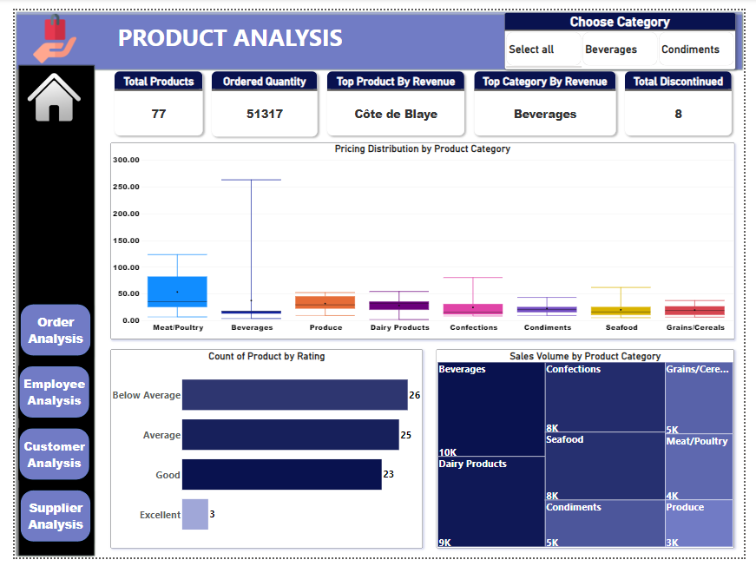

Slide 28
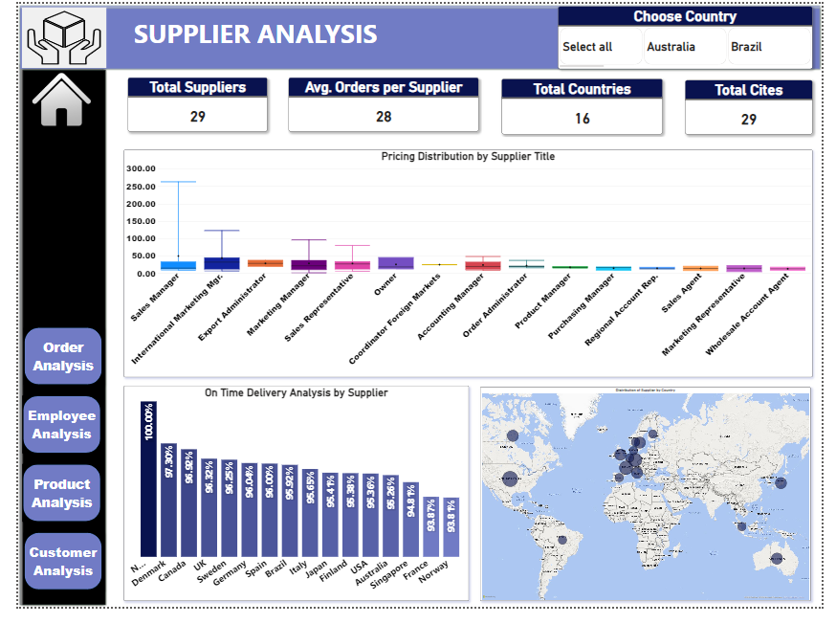

Slide 29
EDA QUESTIONS
What are the key factors influencing customer retention or loyalty based on the dataset?
How do customer preferences vary based on their location or demographics? Can we explore this through interactive visualizations?
Are there any interesting patterns or clusters in customer behavior that can be visualized to identify potential market segments?
Are there any specific product categories or SKUs that contribute significantly to order revenue? Can we identify them through visualizations?
Are there any correlations between order size and customer demographics or product categories? Can we explore this visually using scatter plots or heatmaps?
How does order frequency vary across different customer segments? Can we visualize this using bar charts or treemaps?
Are there any correlations between employee satisfaction levels and key performance indicators? Can we explore this visually through scatter plots or line charts?
How does employee turnover vary across different departments or job roles? Can we visualize this using bar charts or heatmaps?
Can we identify any patterns or clusters in employee skill sets or qualifications through visualizations? How can this information be used for talent management?
Are there any correlations between product attributes (e.g., size, color, features) and sales performance? Can we explore this visually using scatter plots or heatmaps?

Slide 30
EDA QUESTIONS
11. How does product demand fluctuate over different seasons or months? Can we visualize this through line charts or area charts?
12. Can we identify any outliers or anomalies in product performance or sales using visualizations? How can this information be used for product optimization?
13.. Are there any correlations between supplier attributes (e.g., location, size, industry) and performance metrics (e.g., on-time delivery, product quality)? Can we explore this visually through scatter plots or heatmaps?
14. How does supplier performance vary across different product categories or departments? Can we visualize this using stacked bar charts or grouped column charts?
15. Can we identify any trends or patterns in supplier costs or pricing structures through visualizations? How can this information be used for procurement optimization?

Slide 31
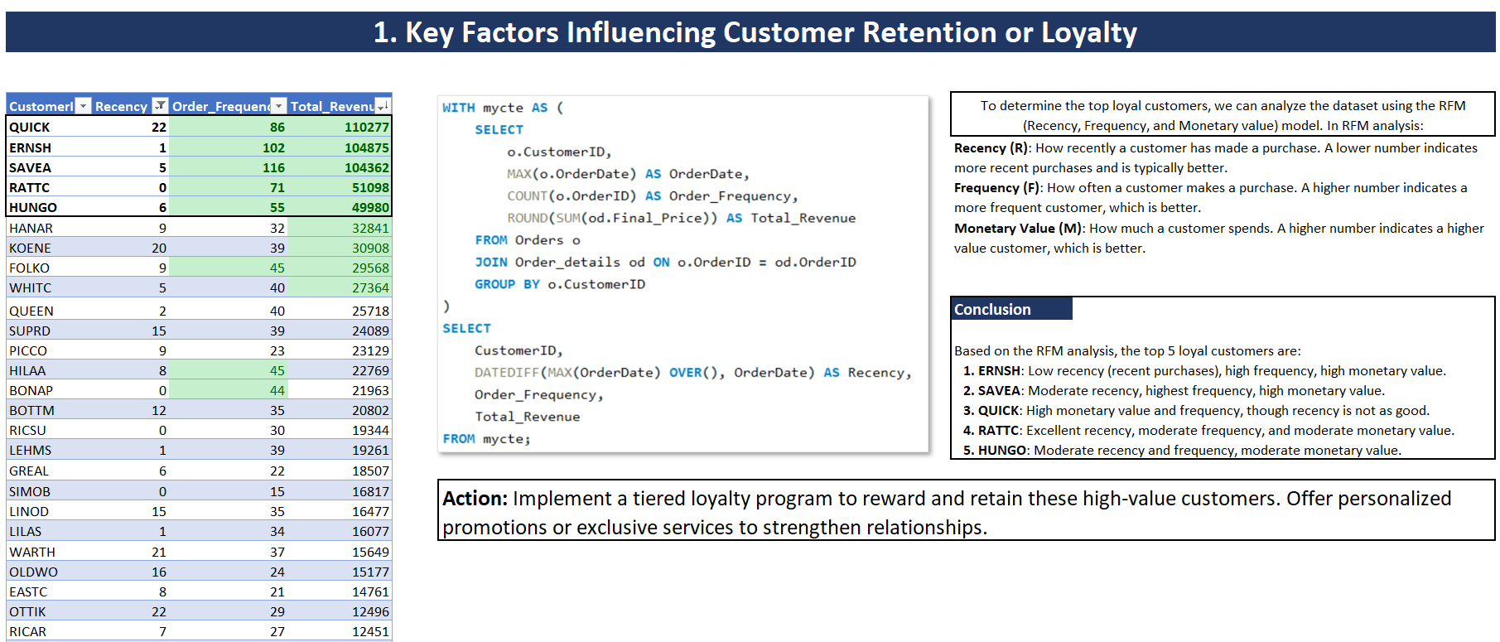

Slide 32
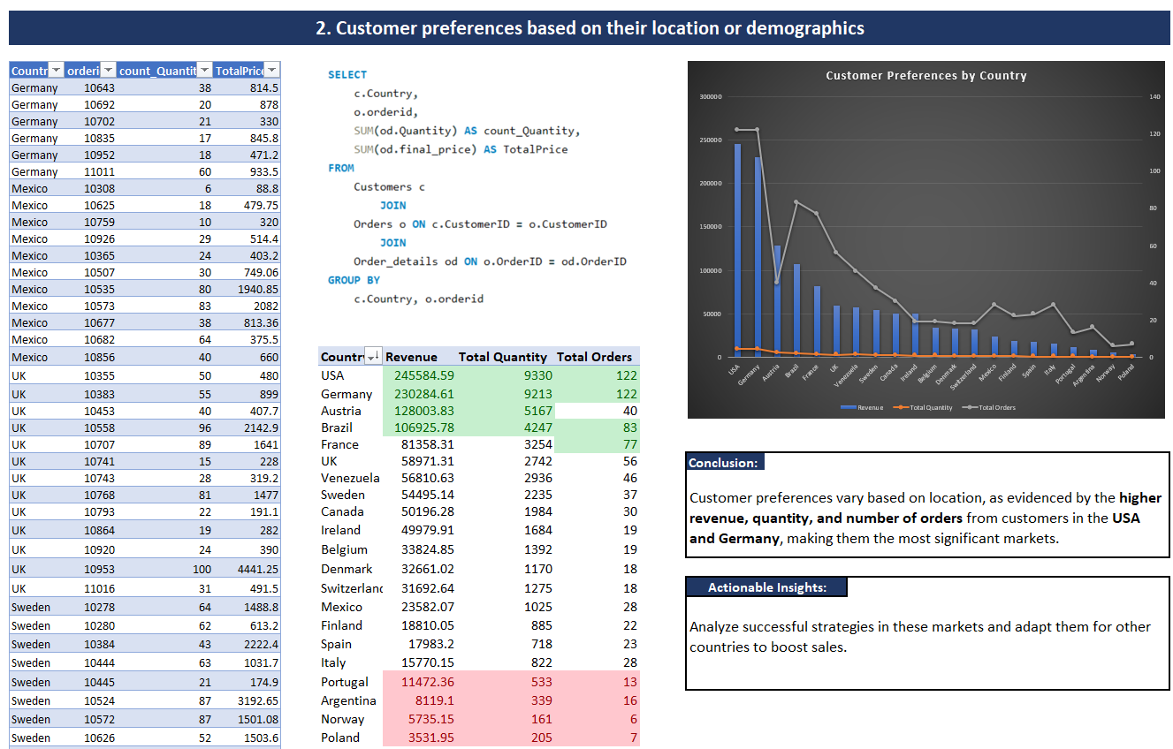

Slide 33
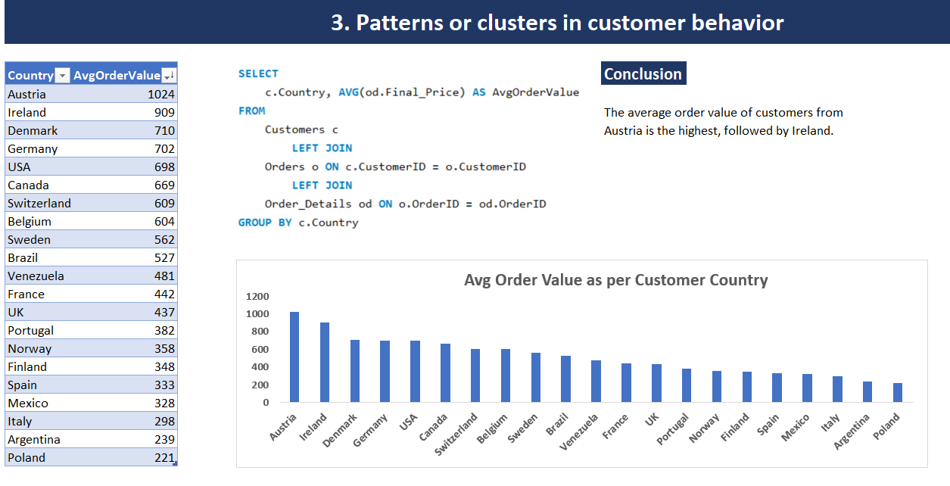

Slide 34
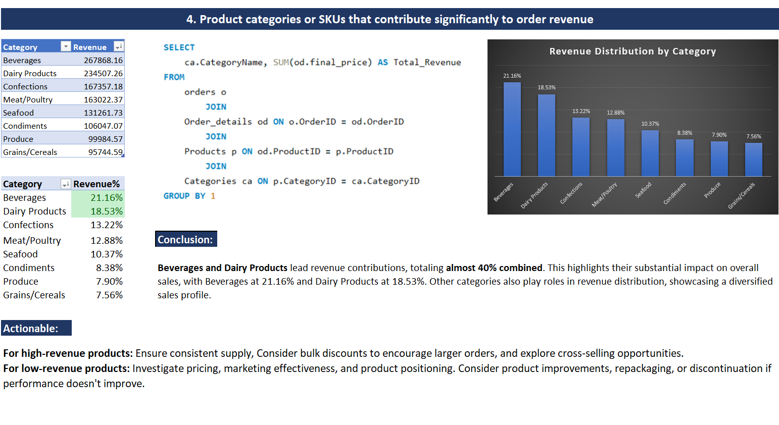

Slide 35
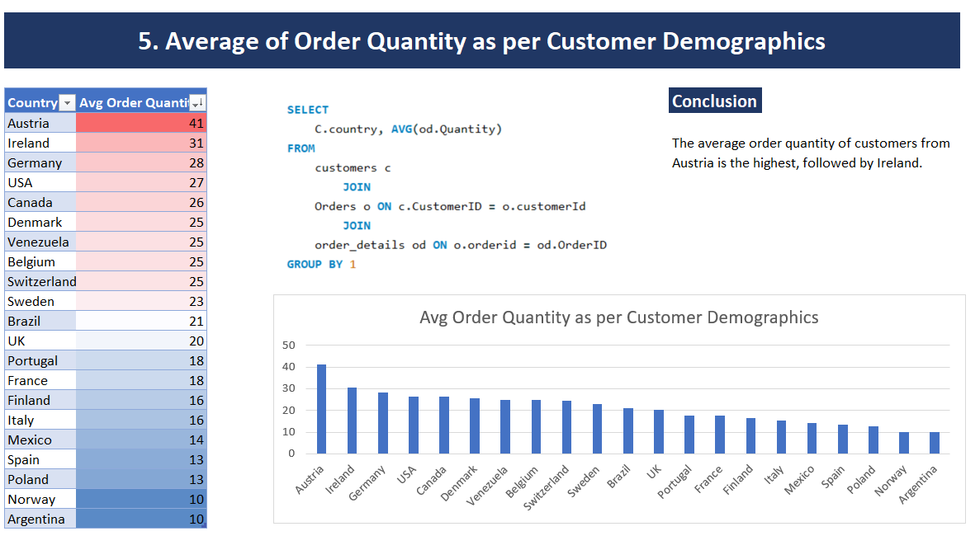

Slide 36
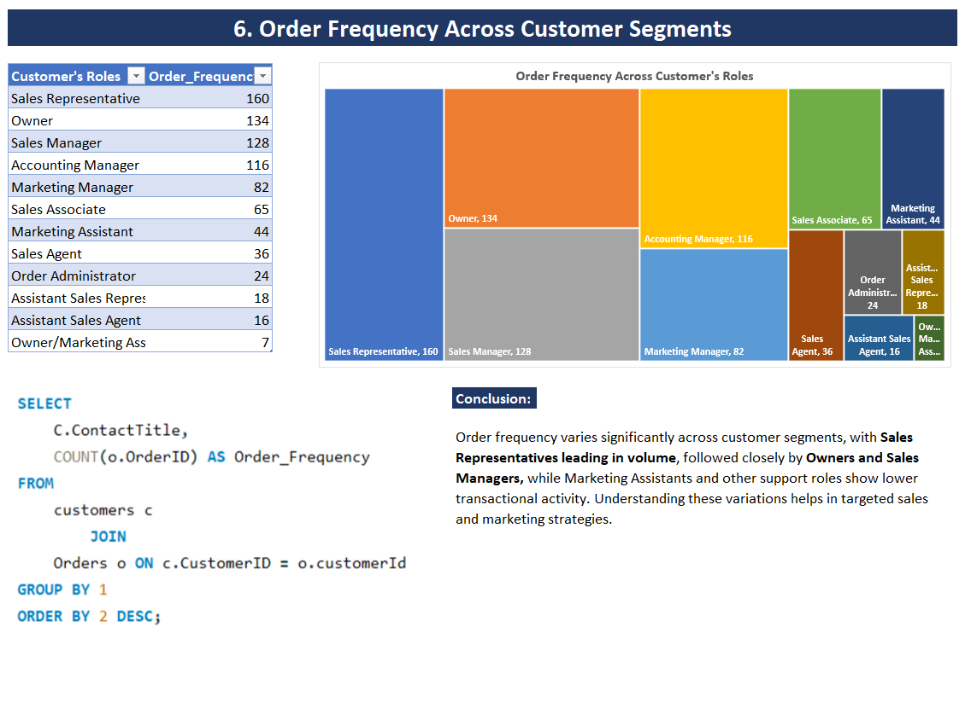

Slide 37
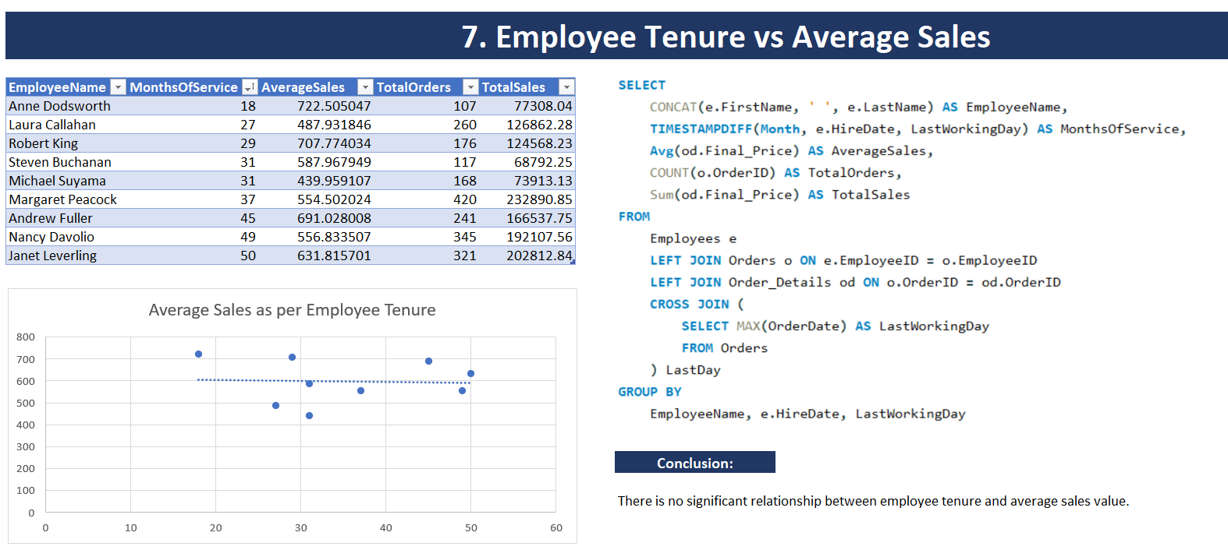

Slide 38
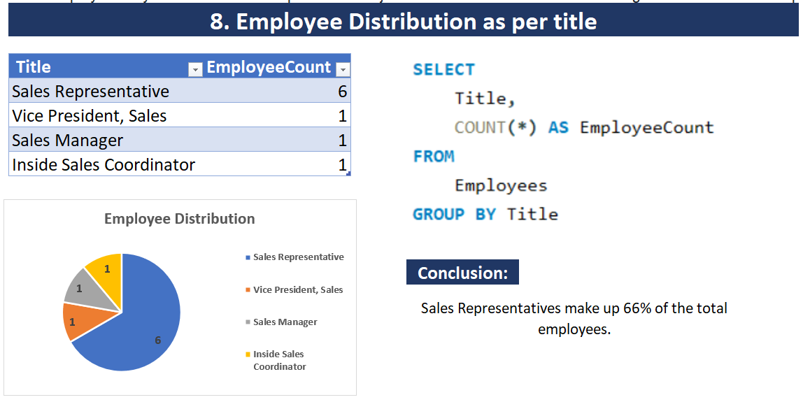

Slide 39
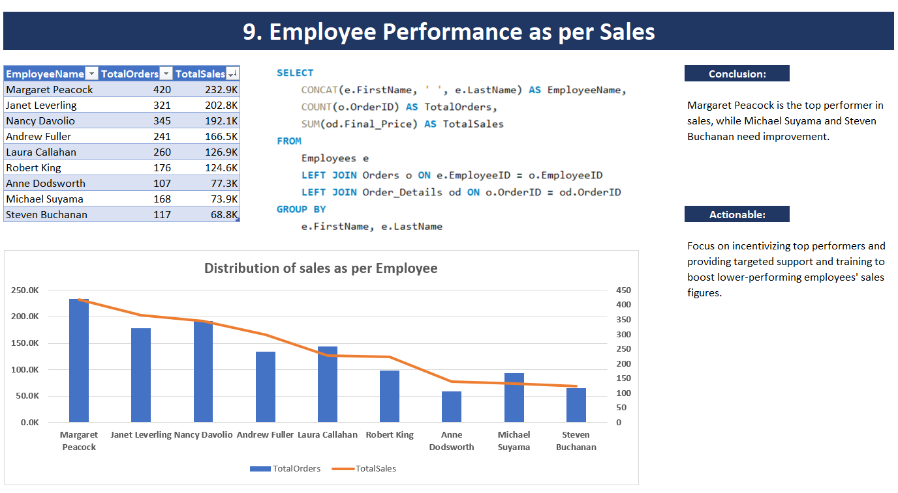

Slide 40
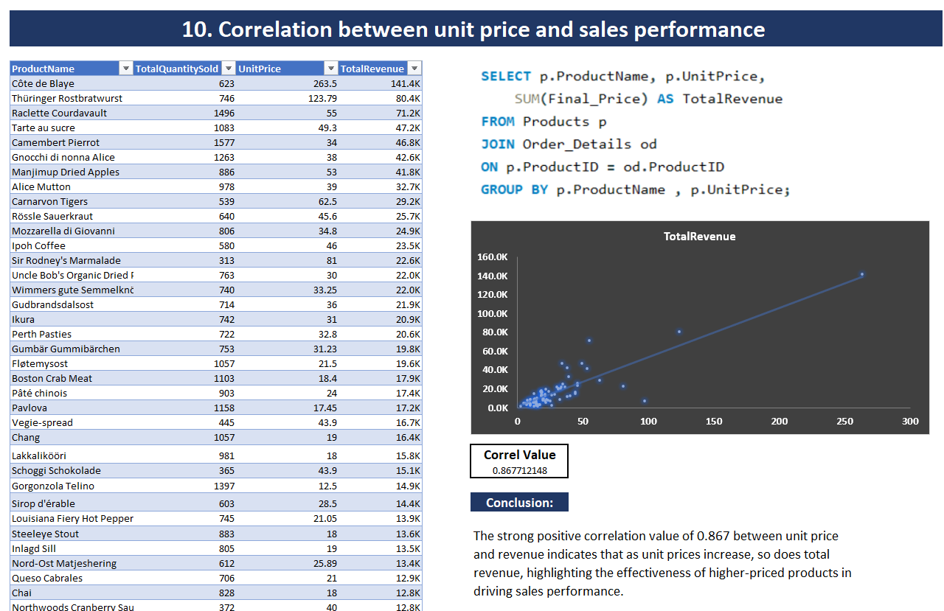

Slide 41
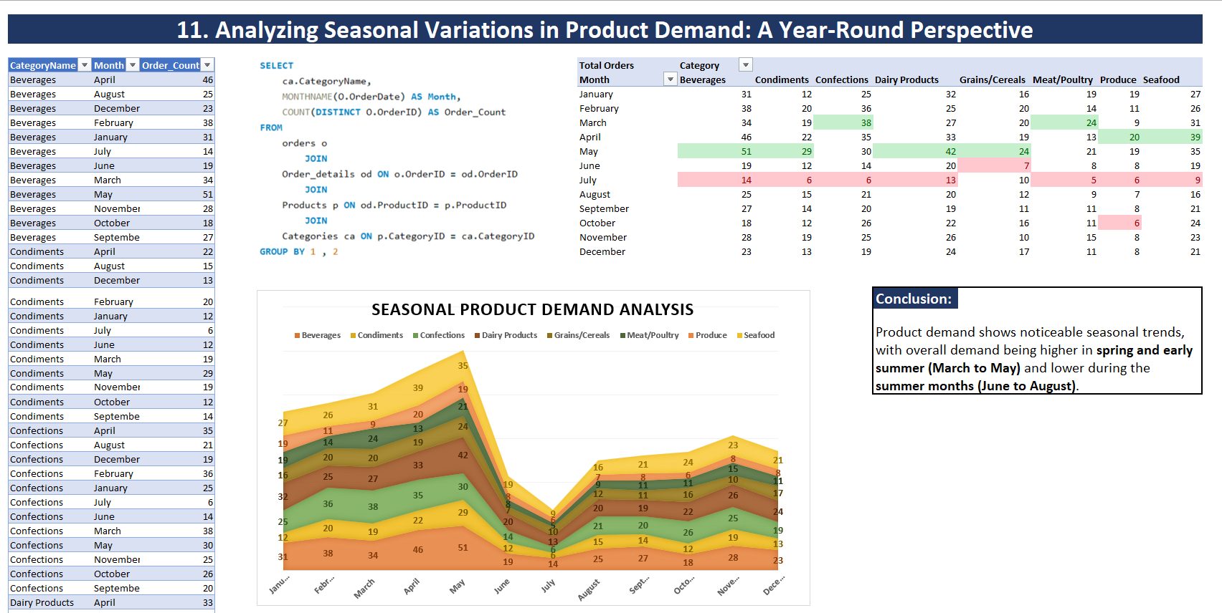

Slide 42
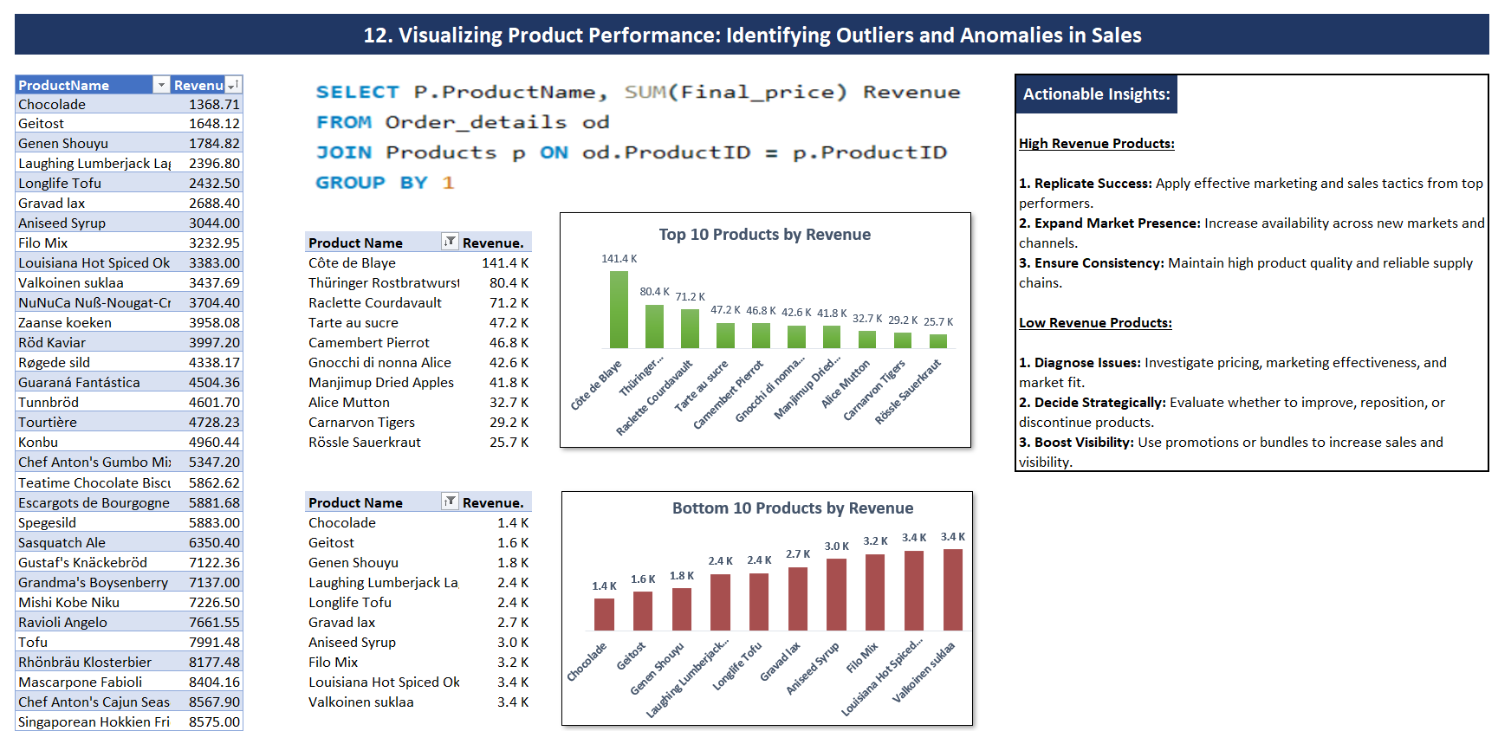

Slide 43
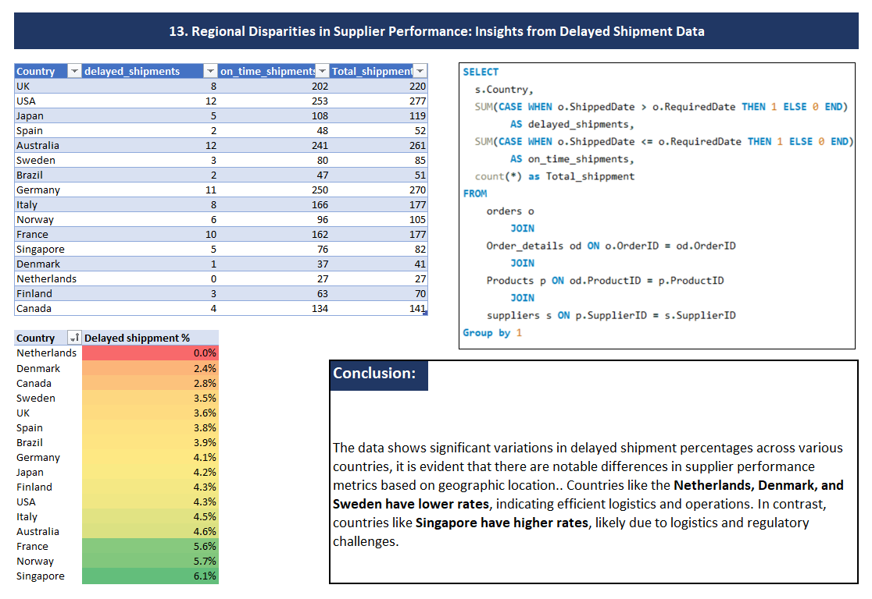

Slide 44
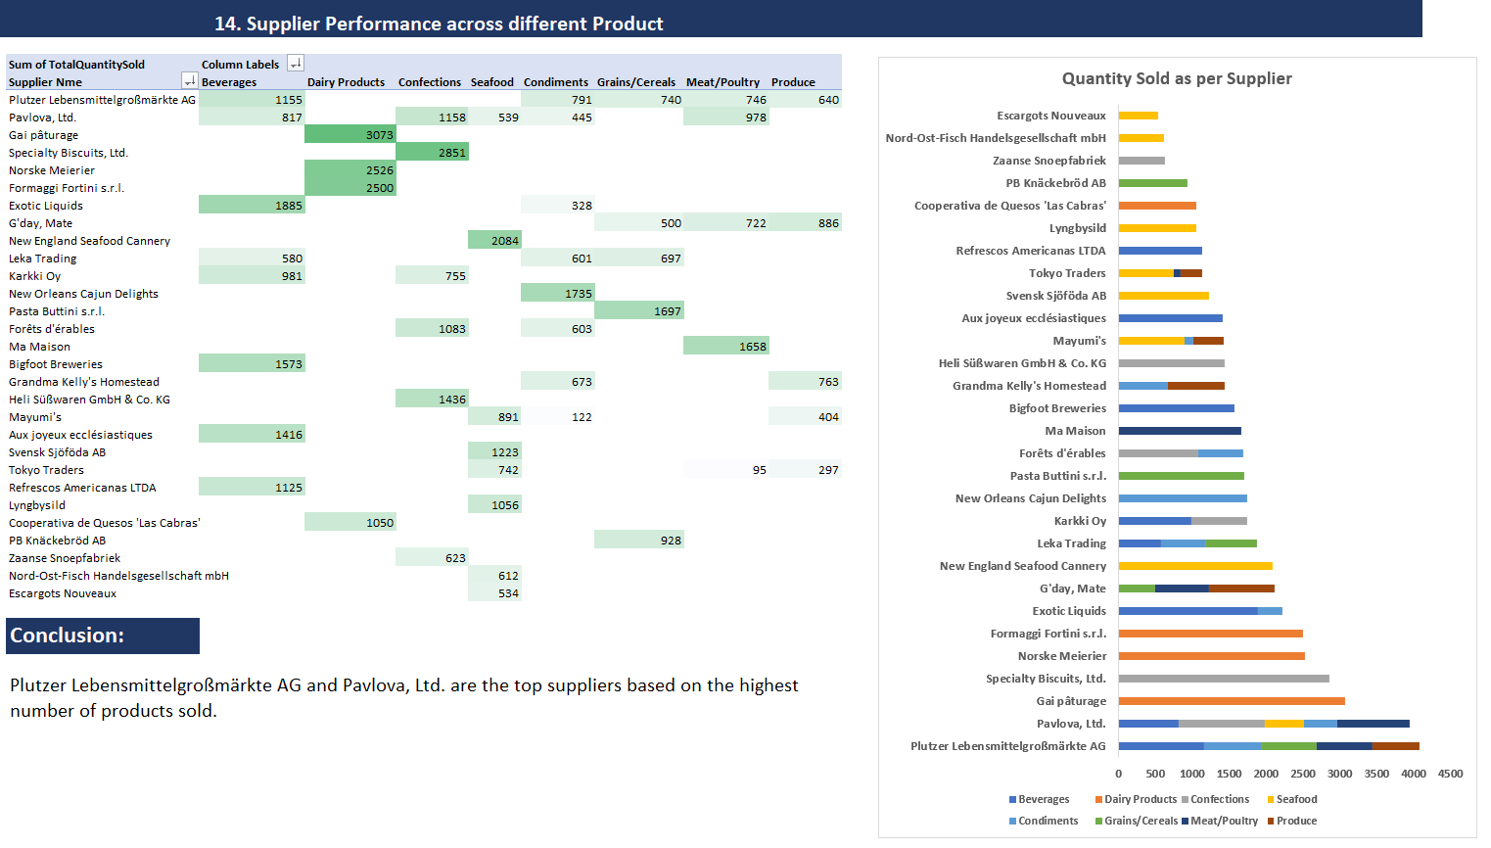

Slide 45
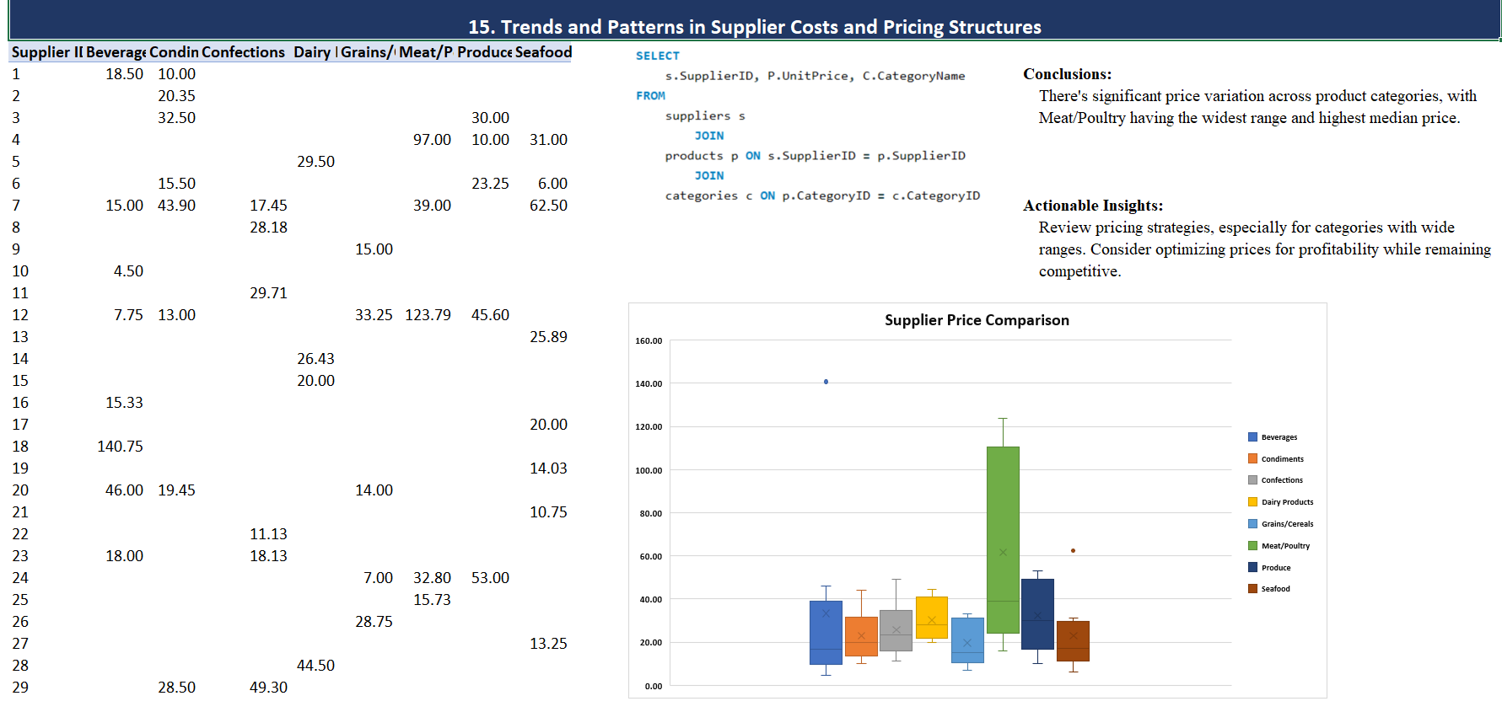

Slide 46
Conclusion
By providing a visually compelling and user-friendly dashboard with interactive features, this Power BI report empowers stakeholders at Northwind Traders to make data-driven decisions. This comprehensive analysis of customers, sales, inventory, and employees offers valuable insights into business operations and facilitates data exploration. The expected impact is a transformation in how Northwind interacts with its data, ultimately enhancing competitiveness and driving the company forward in the wholesale market.

Slide 47

Thank you

